Slide 1

Hiring Process Analytics
Ruchita Parmar

Slide 2
Project Description
Provided dataset of the company.
where the details about people who registered for a particular post in a department of this company
As an analyst I have use my knowledge in statistics and use different formulas in excel and draw necessary conclusions about the company.
Attributes: application_id,
Interview Takeon,
Statusevent_name,
Department,
Post Name,
Offered Salary

Slide 3
Approach
Firstly i upload the dataset and try to understand the data and its pattern
I performing analysis on Microsoft Excel using various in-built formula of Excel and we will go step by step in finding out the answers to
the questions asked related to the data set.
create table use MIN, MAX, AVG, COUNTIF and other statistic formulas.
draw the given task and save my answer sheet

Slide 4
Tech-Stack Used
MS Excel
Jupyter Notebook
Internet
MS PowerPoint
Github

Slide 5

Insights/Result

Slide 6
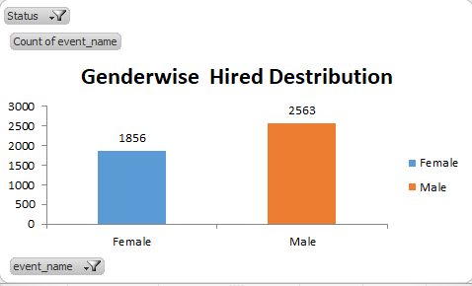
How many males and females are Hired ?

Slide 7
What is the average salary offered in this company ?
Overall Average salary of the company →49983.03
Department Name | Department wise Average Salary
Finance Department | 49628.01
General Management | 58722.09
Human Resource Department | 49002.28
Marketing Department | 48489.94
Operations Department | 49151.35
Production Department | 49448.48
Purchase Department | 52564.77
Sales Department | 49310.38
Service Department | 50629.88
Overall Average Salary | 49983.03

Slide 8
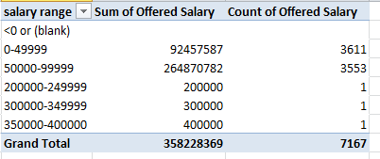
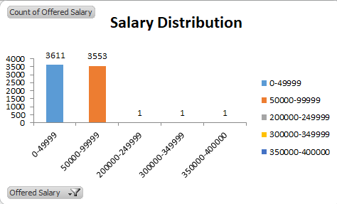
Draw the class intervals for salary in the company ?

Slide 9
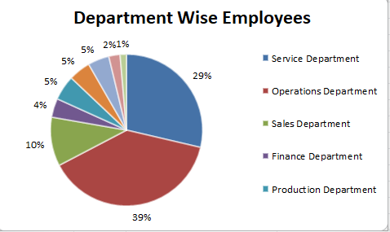
Draw Pie Chart / Bar Graph ( or any other graph ) to show proportion of people working different department ?

Slide 10
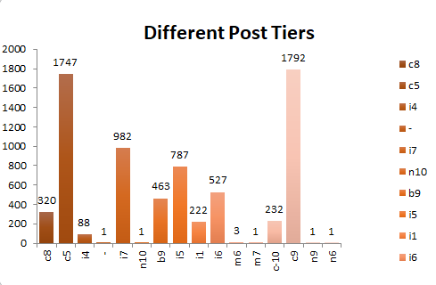
Represent different post tiers using chart/graph?

Slide 11
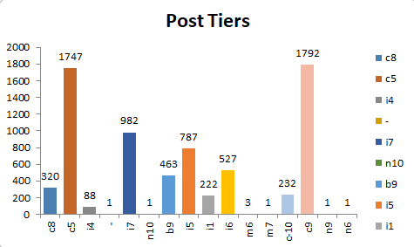
Represent different post tiers using chart/graph?

Slide 12

EDA
In the EDA I analysis the null values , find the outlier, Remove and correlation

Slide 13
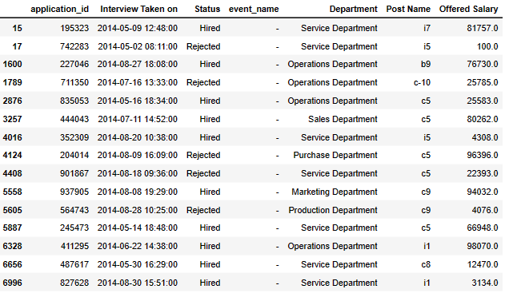
Null value analysis

Slide 14
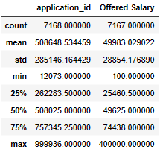
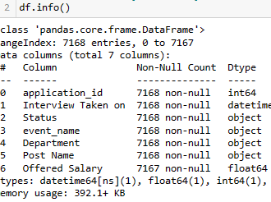
Statistic analysis and information about data

Slide 15
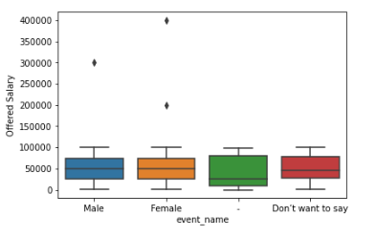
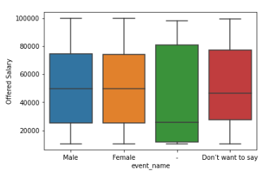
Outlier find and Remove

Slide 16
I done more analysis in EDA
Please check the bellow link
https://github.com/ruchita51/Trainity/blob/main/hiring_process_analysis.ipynb

Slide 17
Thank you

